Slide 1
continuous delivery with oltp
- Jon Shaulis

Slide 2
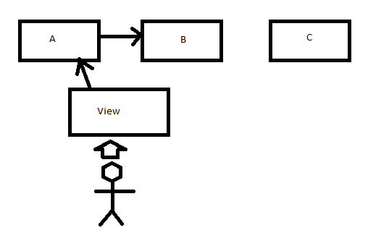
Database continuous development with staging tables
Method 1
Initial Setup:
Table A is connected to the view. User interacts with view which pulls or modifies results in A.
Results modified are replicated over to B
Notes:
Initial Setup:
Table A is connected to the view. User interacts with view which pulls or modifies results in A.
Results modified are replicated over to B

Slide 3
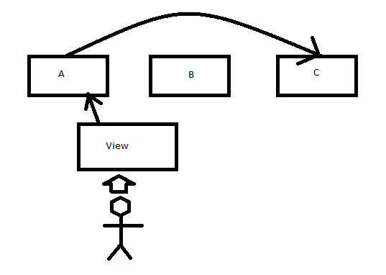
Database continuous development with staging tables
Method 1
Table preparation:
We alter the trigger to point to Table C to catch any changes.
While Table A and Table C receive changes, we are free to work on Table B without user impact.
Notes:
Table preparation:
We alter the trigger to point to Table C to catch any changes.
While Table A and Table C receive changes, we are free to work on Table B without user impact.

Slide 4
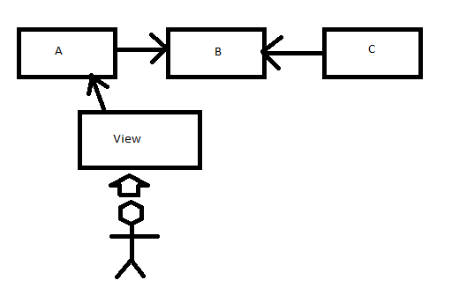
Database continuous development with staging tables
Method 1
Beginning Transition:
Table B is now changed and ready to be put back into sync.
Carry changes from Table C to Table B.
Adjust the trigger on Table A to point back to Table B.
Notes:
Beginning Transition:
Table B is now changed and ready to be put back into sync.
Carry changes from Table C to Table B.
Adjust the trigger on Table A to point back to Table B.

Slide 5
Database continuous development with staging tables
Method 1
Finishing Transition:
Table B has the change made, and is receiving data back from A staying in sync.
We can now perform the same change on Table C.
Notes:
Finishing Transition:
Table B has the change made, and is receiving data back from A staying in sync.
We can now perform the same change on Table C.

Slide 6
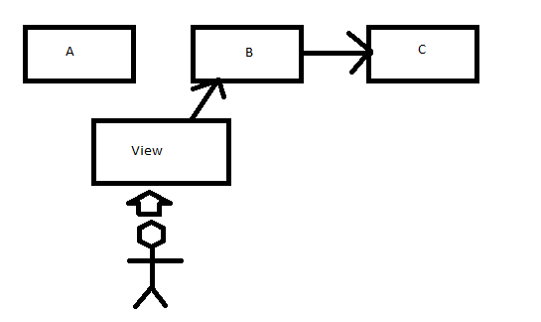
Database continuous development with staging tables
Method 1
Modifying Table A:
We add the trigger to B to catch any changes.
We switch the view to point to Table B.
We can now begin work on Table A without impacting the user.
Notes:
Modifying Table A:
We add the trigger to B to catch any changes.
We switch the view to point to Table B.
We can now begin work on Table A without impacting the user.

Slide 7
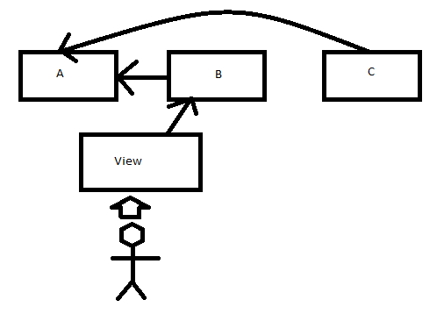
Database continuous development with staging tables
Method 1
Syncing our tables:
We alter the trigger on Table B to point back to Table A.
We carry the changes from Table C to Table A.
We have now modified our environment without impacting the availability to the user.
Notes:
Syncing our tables:
We alter the trigger on Table B to point back to Table A.
We carry the changes from Table C to Table A.
We have now modified our environment without impacting the availability to the user.

Slide 8


Database continuous development with staging tables
Method 1
PROS
CONS
Cheap. You don’t have to maintain many environments.
You have extreme precision and can create your own processes to ensure availability. Some methods may require switching an entire instance, you can do this at the table level.
Easily repeatable with saving scripts.
Taxing on the hardware. Replicating the data with replication, log shipping, ETL, triggers, mirror, or other methods spends effort on the hardware and stronger hardware is required or users will feel impact.
Extremely difficult to maintain and automate. Dynamic SQL may be necessary for automation and can pose a security risk.
Slow and tedious to setup, there are other automated ways of delivery that can be done substantially faster.

Slide 9
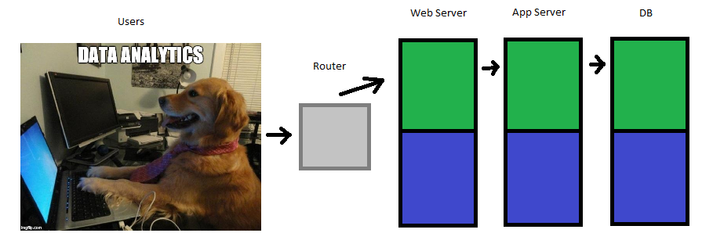
Database continuous development with Blue / Green
Method 2
As illustrated, this method involves having two identical environments.
This allows us to make changes on Blue without impacting Green.
Notes:
As illustrated, this method involves having two identical environments.
This allows us to make changes on Blue without impacting Green.

Slide 10
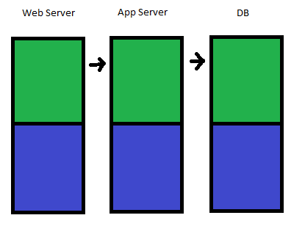
Database continuous development with Blue / Green
Method 2
Patches
Patches can be cycled between green and blue after they had already passed previous environments if you want to watch the behavior of the patches in prod without impacting the customer.
Notes:
Week 1: Patches
- I like to give patches a “burn in” period if possible. Ideally we can bring them up through the environments with testing. This gives us a final test with prod data.

Slide 11
Database continuous development with Blue / Green
Method 2
Schema
- Ideally in deployment, we deploy the schema and framework before the features and data. This will make rollback easier in either event if something were to go wrong. Snapshots can be taken before each implementation.
Notes:
Week 2: Schema
- Now we can make schema changes in Blue. This allows us to make a framework to allow for an easier rollback.

Slide 12
Database continuous development with Blue / Green
Method 2
Features
- Once the framework and schema is in place, the data can be deployed. If there is an issue, we can roll back to the previous snapshot. The customer is unaware any changes are occurring.
Notes:
Week 3: Features
- We have our patches, our schema, and now we can add our dependencies based on the frameworks / schema changes we made in week 2. This allows for easier roll back if there are problems and allows for the environments to stay more easily in sync.

Slide 13
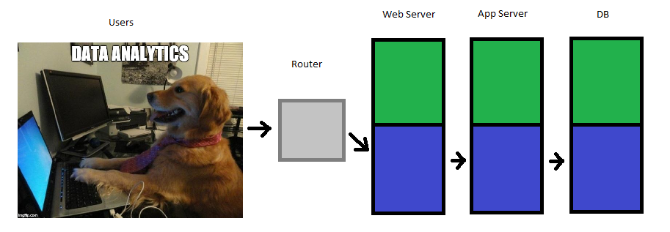
Database continuous development with Blue / Green
Method 2
Switch-a-roo
Once things are working fine with the upgrades, we can
switch the router over to the other stack without causing any issues.
Notes:
Week 4: Switch-a-roo
We switch the route to Blue. If things go well, we make
the changes to Green and repeat next deployment.

Slide 14


Database continuous development with staging tables
Method 2
PROS
CONS
Instant fail back recovery if a deployment goes south.
Easily lines up with deployment automation, streamlining the time your developers and systems team spends.
Adds to testing rigor.
Couples as a High Availability plan for customers rather than doing something such as clustering.
$$$$ You are maintaining two identical environments.
You can run into sync issues, this can be circumvented through proper policy and procedure.
Very steep setup and planning required.

